Slide 1


GDP and Consumer Price Index Analysis
Understanding the economic growth of Rwanda
Presenters:
Okeke Christian
Samuel Olubode
(Team: DataDynamos)

Slide 2
Content
GDP Trends Analysis
CPI Dynamics
Interactive Dashboard Demo
Key Takeaways

Slide 3
Purpose of the Dashboard
“To provide real-time insights into economic indicators like GDP and CPI”
Key Audience
Economic Analysts and Researchers
Policy Makers and Government Officials
Investors, Managers and Financial Analysts
Academics and Students
General Public with Interest in Economics

Slide 4
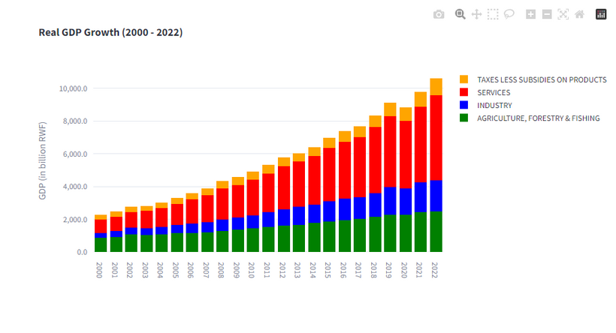
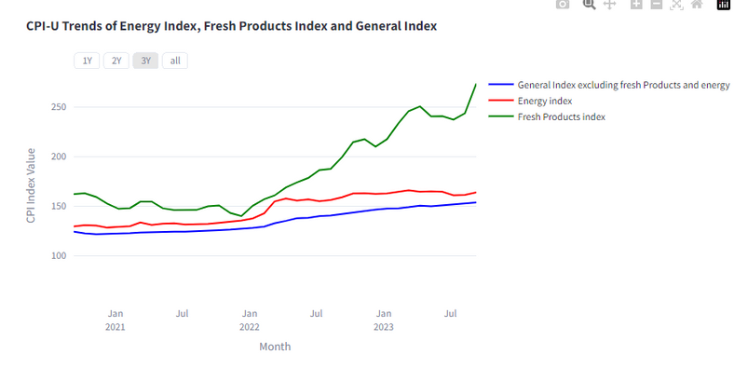
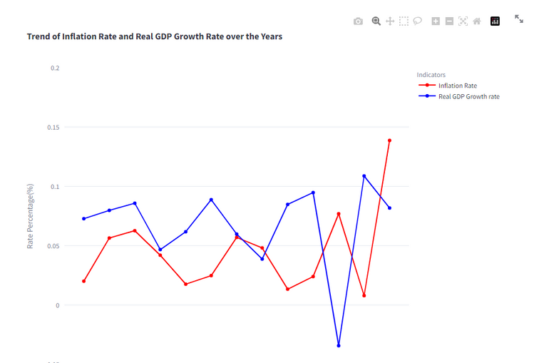
The Dashboard at a Glance
GDP Overview
CPI Analysis
Comparison of GDP To Inflation

Slide 5
Live Demo

Slide 6



The economy remains resilient
*mainly supported by a robust performance in the services sector.
Major Insights from GDP Analysis
Climatic conditions & Global political, socio-economic crisis
*are major causes of fluctuations in the GDP growth.

Slide 7

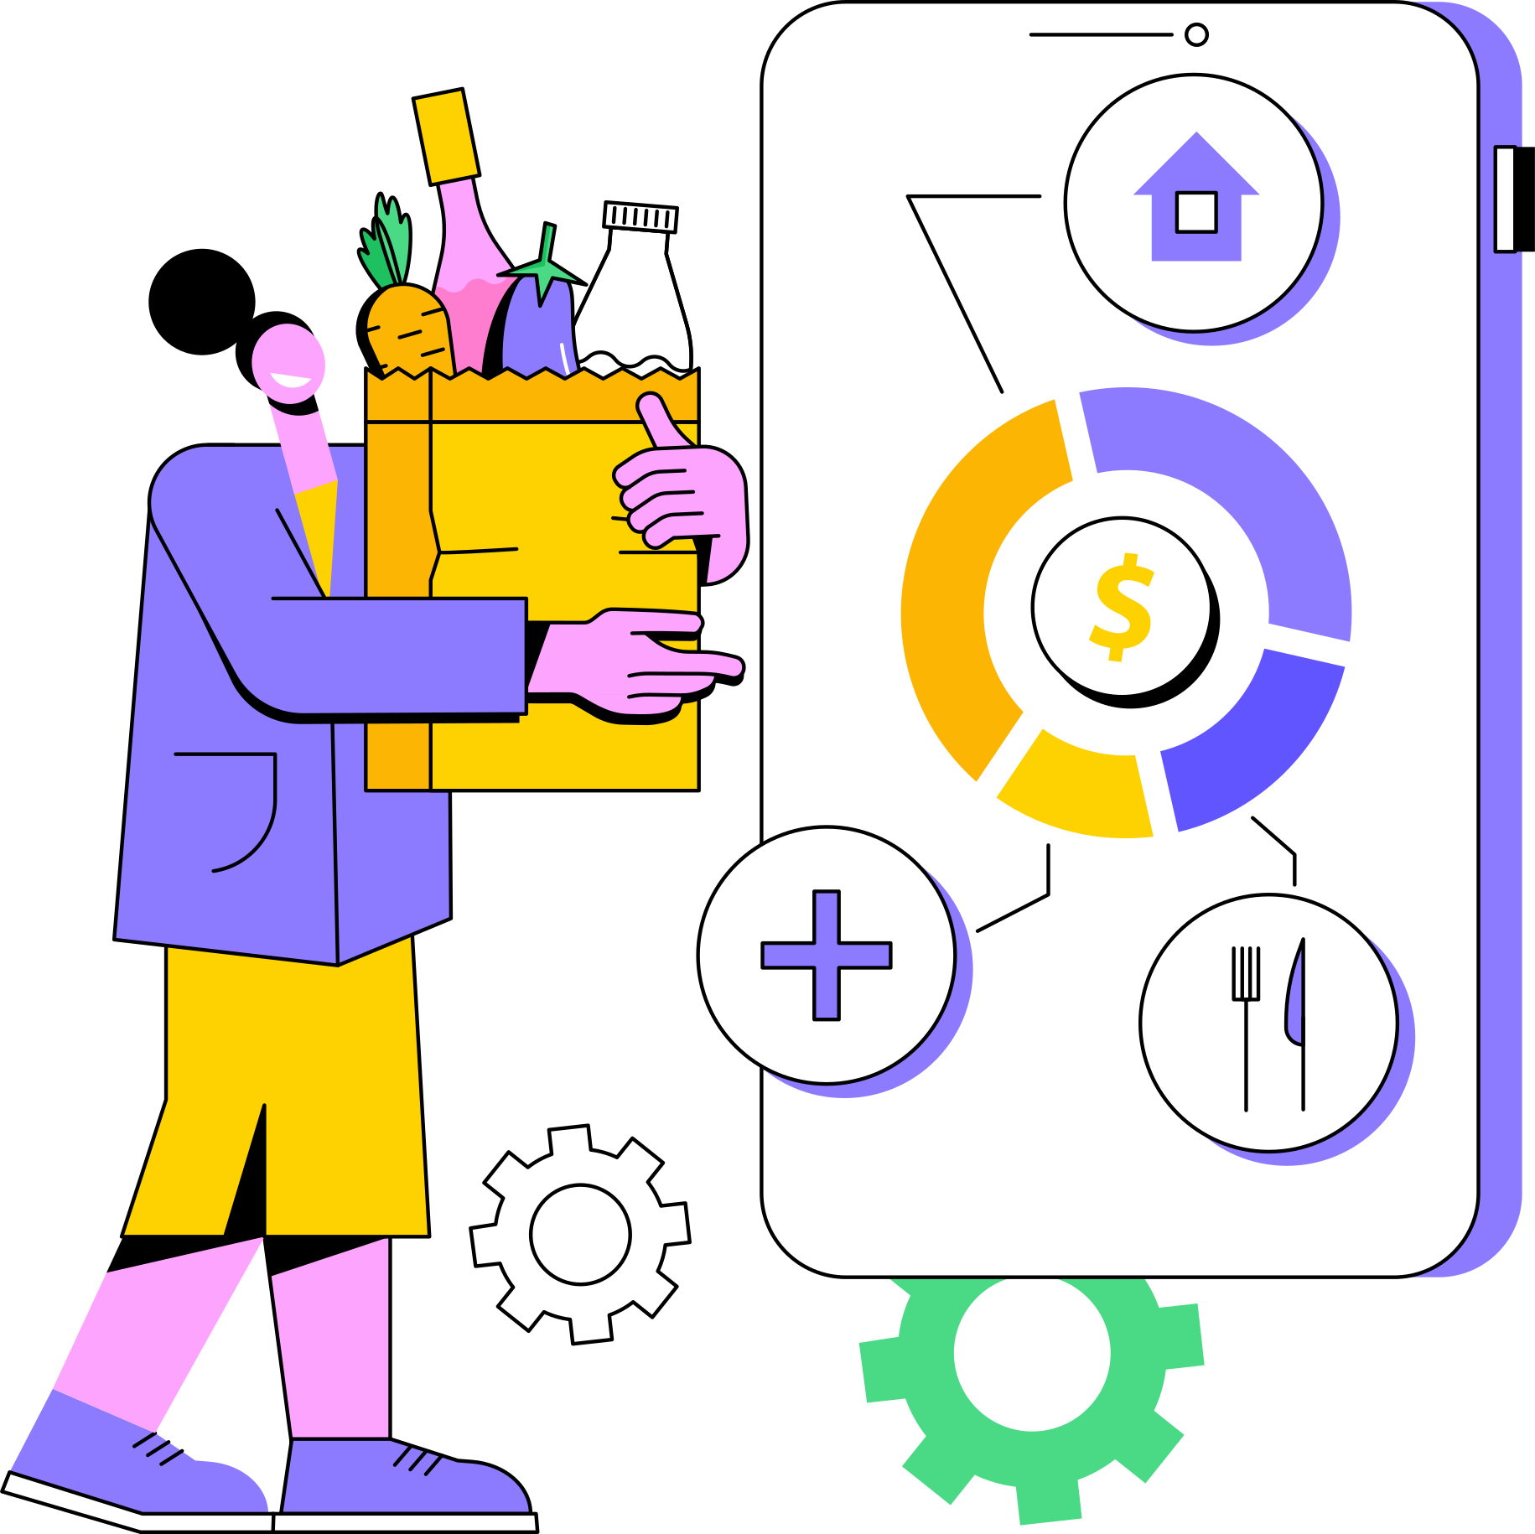
11.2%
Food prices have the highest inflation rate
*mainly due to climatic effects on agriculture and global supply chain crises from Russia-Ukraine war
INFLATION RATE
Major Insights from CPI Analysis
Increased economic pressures persists
*slowly recovery from COVID-19

Slide 8
“Inflation is taxation without legislation”
Milton Firedman, noble laureate economist
Thank You!

